Slide 1
Unified Modeling Language
Nội dung
I. Lịch sử ra đời
II. Phân loại
1. Phân loại
2. Hệ thống ký hiệu cơ bản
3. Ví dụ
III. Thiết kế mẫu
1. Sequence diagram
2. State machine diagram

Slide 2
Unified Modeling Language
Nội dung
I. Lịch sử ra đời
II. Phân loại
1. Phân loại
2. Hệ thống ký hiệu cơ bản
3. Ví dụ
III. Thiết kế mẫu
1. Sequence diagram
2. State machine diagram

Slide 3
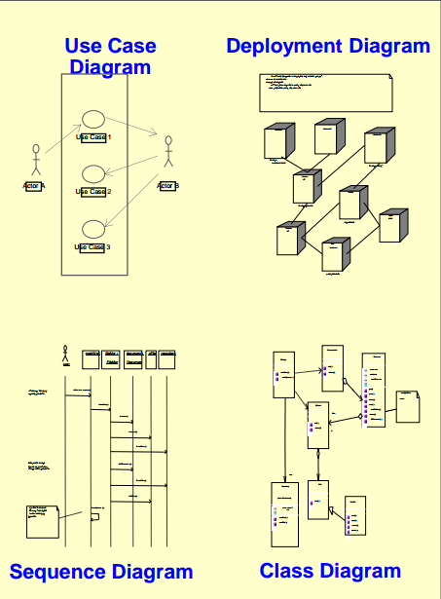
Unified Modeling Language
I. Tổng quan
1.1 Giới thiệu
+ UML là ngôn ngữ hình ảnh dùng cho thiết kế software.
+ UML là ngôn ngữ chung để Visualize, Specify, Construct and Document software system.
+ UML có quan hệ trực tiếp đến Object Oriented Analysis and Design.

Slide 4
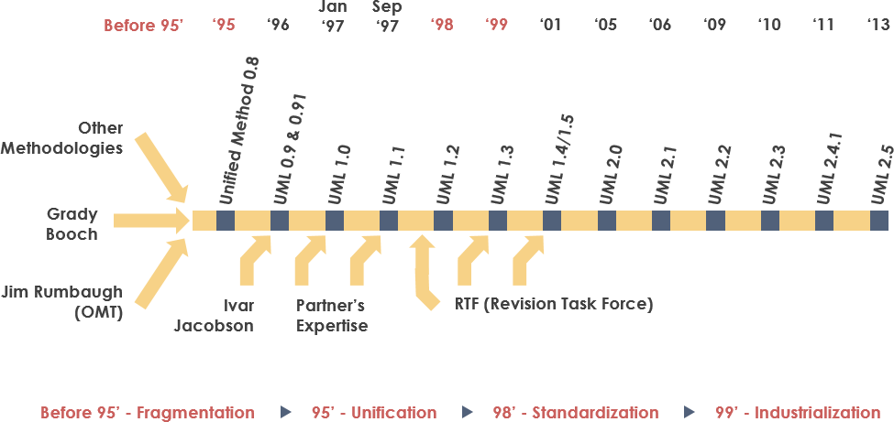
Unified Modeling Language
I. Tổng quan
1.2 Lịch sử
+ Vào 1994, có hơn 50 phương pháp mô hình hóa hướng đối tượng.
(Fusion, Shlaer-Mellor, ROOM, Class-Relation,Wirfs-Brock,Coad-Yourdon, MOSES)

Slide 5
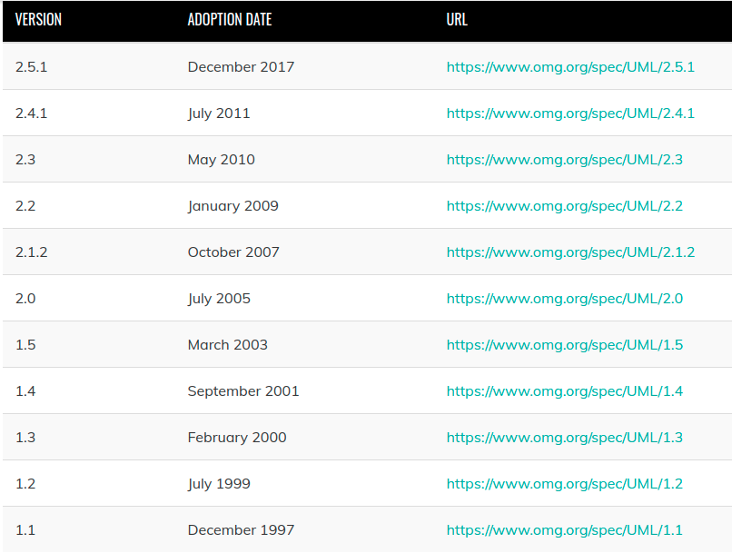
Unified Modeling Language
I. Tổng quan
1.2 Lịch sử
+ Mang tính thống nhất trong phân tích và thiết kế.
+ UML được công nhận là chuẩn chung vào 1997.

Slide 6
Unified Modeling Language
Nội dung
I. Lịch sử ra đời
II. Phân loại
1. Phân loại
2. Hệ thống ký hiệu cơ bản
3. Ví dụ
III. Thiết kế mẫu
1. Sequence diagram
2. State machine diagram

Slide 7
Unified Modeling Language
1.1. Cách 1
Structural UML diagrams
+ Static structure diagrams
- Class diagram
- Object diagram
+ Implementation diagrams
- Component diagram
- Deployment diagram
+ Composite structure diagram
+ Package diagram
+ Profile diagram
Behavior UML diagrams
+ Activity diagram
+ Interaction diagram [2.0]
- Communication diagram
- Sequence diagram
+ State machine diagram
- Timing diagram [2.0]
- Use case diagram

Slide 8
Unified Modeling Language
1.2. Cách 2 (Theo giai đoạn phát triển hệ thống)
Class diagram
Object diagram
Design
Implementation
Component diagram
1
2
Use Case
Deployment
Process
Class diagram
Object diagram
Component diagram
4
3

Slide 9
Unified Modeling Language
Mô hình hóa hệ thống
Architectural Modeling
[Blueprint of the entire system]
Bahavioral Modeling
Structural
Modeling
Structural
Modeling
Structural
Modeling

Slide 10
Unified Modeling Language
Nội dung
I. Lịch sử ra đời
II. Phân loại
1. Phân loại
2. Hệ thống ký hiệu cơ bản
3. Ví dụ
III. Thiết kế mẫu
1. Sequence diagram
2. State machine diagram

Slide 11
Unified Modeling Language
Class
Object
Interface
Collaboration
Use case
Active classes
Components
Nodes
Structural Things
[Notational System]

Slide 12
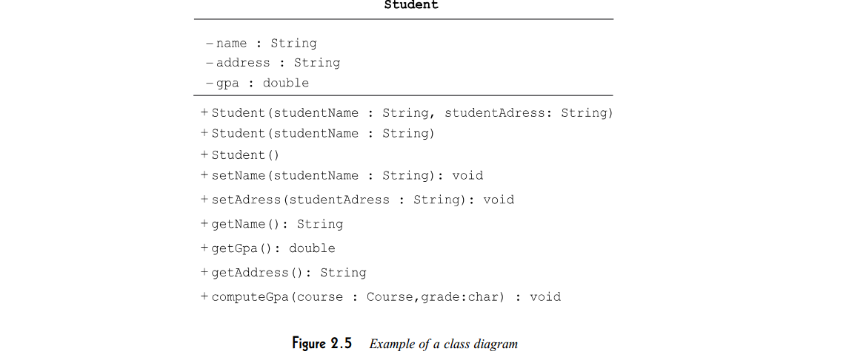
Unified Modeling Language
1. Class notation
Class
Visibility
Student
Name
Public
+ name : String
# roll: Interger
- section: String
Protected
Attributes
Private
+ Display()
- Add()
- Edit()
# Delete()
Opreations
Extra component
(This is not mandatory)
Responsibilities
Mamage student in a class

Slide 13
Unified Modeling Language
2. Object notation
Class
Visibility
Student
Name
Public
+ name : String
# roll: Interger
- section: String
Protected
Attributes
Private
+ Display()
- Add()
- Edit()
# Delete()
Opreations
Extra component
(This is not mandatory)
Responsibilities
Mamage student in a class

Slide 14
Unified Modeling Language
3. Interface notation
Interface is used to describe the functionality without implementation.
Interface
StudentApplication
Name

Slide 15
Unified Modeling Language
4. Collaboration notation
Collaboration represents responsibilities.
Collaboration
Group of responsibilities
Name
Additional components can be used for clarification

Slide 16
Unified Modeling Language
5. Use case notation
Use case is used to capture hight level functionalities of a system.
Use case
Register Student
Name
Additional components can be used for clarification

Slide 17
Unified Modeling Language
6. Actor notation
An actor is used in a use case diagram to describe the internal or external entities.
Actor

Slide 18
Unified Modeling Language
7. Initial state notation
7. Initial state notation
8. Final state notation
The usage of Initial State Notation is to show the starting point of a process.
The usage of Initial State Notation is to show the starting point of a process.
The usage of Initial State Notation is to show the starting point of a process.
Initial State
Initial State
Final State

Slide 19
Unified Modeling Language
9. Active class notation
Active class looks similar to a class with a solid border.
Active class is used to represent the concurrency in a system.
Active Class
School
Name
+ name : String
+ address: String
Attributes
+ addDeparment()
Opreations

Slide 20
Unified Modeling Language
10. Component notation
Component is used to represent any part of a system for which UML diagrams are made.
Component
Institution
name
Additional components can be added

Slide 21
Unified Modeling Language
11. Node notation
Node is used to represent the physical part of a system such as the server, network, etc.
Node
Server
name

Slide 22
Unified Modeling Language
12. Interaction notation
Interaction is used to represent the communication among the components of a system.
object
Interaction
Run after page loaded
call
:UIController
:AppController
:BudgetController
init()
displayBudget()
setupEventListener()
lifeline
getDOMStrings()
self call
message
Click keypress
return
ctrlAddItem()
getInput()
recursion

Slide 23
Unified Modeling Language
13. State machine notation
State machine is used to describe different states of a system component.
Initial state
of object
Intermediate state
Transition
Insert card
Idle
Insert PIN
Number
Select from
menu
Abnormal
exit
Final state
(Failure)
Action
Confirm by pushing menu
(Event)
Initial state
Initial state
Confirmation
Final state
Complete transaction

Slide 24
Unified Modeling Language
14. Package notation (Grouping things)
Organizing the UML models is one of the most important aspects of the design. In UML, there is only one element available for grouping and that is package.
Package
name
Components
Additional components can be used for clarification

Slide 25
Unified Modeling Language
15. Note notation (Annotational things)
These notations are used to provide necessary information of a system.
Note
Note is added here for additional
information
Note

Slide 26
Unified Modeling Language
16. Relationships
Dependency
Relationship
Extensibility
Association
Generalization
(Inheritance)

Slide 27
Unified Modeling Language
16. Relationships
1. Dependency notation
Dependency is an important aspect in UML elements.
It describes the dependent elements and the direction of dependency.
name
Name of the element
Independent
Dependent

Slide 28
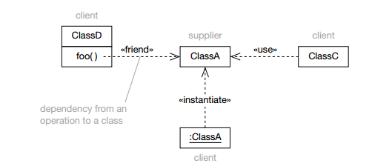
Unified Modeling Language
16. Relationships
1. Dependency notation
Không tồn tại trong Java

Slide 29
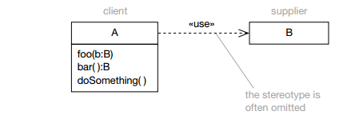
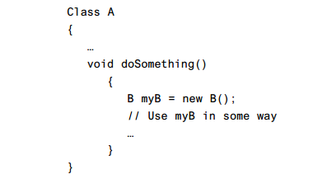
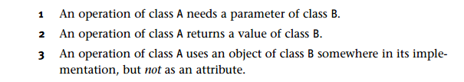
Unified Modeling Language
16. Relationships
1. Dependency notation

Slide 30
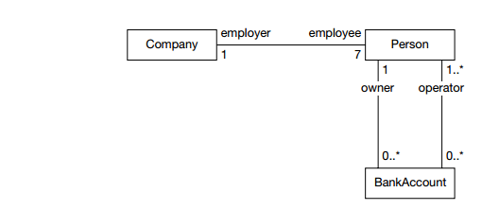
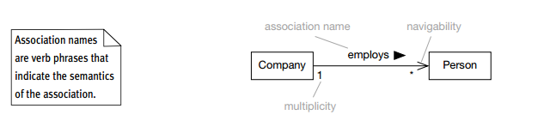
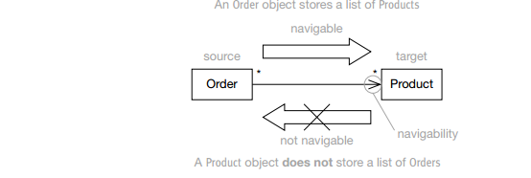
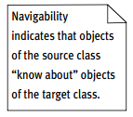
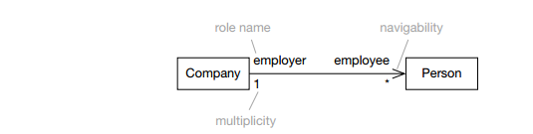
Unified Modeling Language
16. Relationships
2. Association notation
Association describes how the elements in a UML diagram are associated.
In simple words, it describes how many elements are taking part in an interaction.

Slide 31
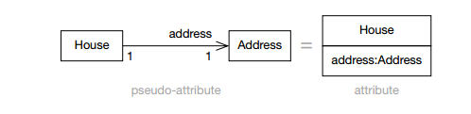
Unified Modeling Language
16. Relationships
2. Association notation
Associations and attributes
Public class House {
private Address address;
}

Slide 32
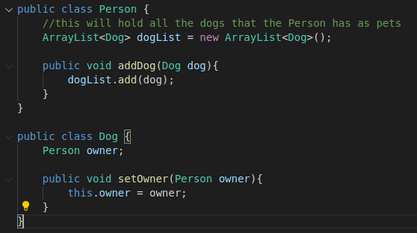
Unified Modeling Language
16. Relationships
2. Association notation
Bidirectional Association
1
*
Person
Dog

Slide 33
Unified Modeling Language
16. Relationships
3. Generalization notation
Generalization describes the inheritance relationship of the object-oriented world. It is a parent and child relationship.
Child
Generalization
Parent

Slide 34
Unified Modeling Language
16. Relationships
4. Extensibility notation
Tagged value
Model no.
(version = 1.2)
Name
Price
Add()
Delete()
Stereotypes
Constraint
{Selling volume in T months}

Slide 35
Unified Modeling Language
Nội dung
I. Lịch sử ra đời
II. Phân loại
1. Phân loại
2. Hệ thống ký hiệu cơ bản
3. Ví dụ
III. Thiết kế mẫu
1. Sequence diagram
2. State machine diagram

Slide 36
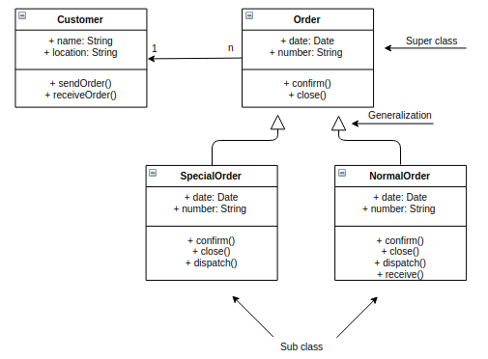
Unified Modeling Language
1. Class diagram (Static structure diagram)
Link Composition and Aggregation: https://www.tutorialspoint.com/Association-Composition-and-Aggregation-in-Java

Slide 37
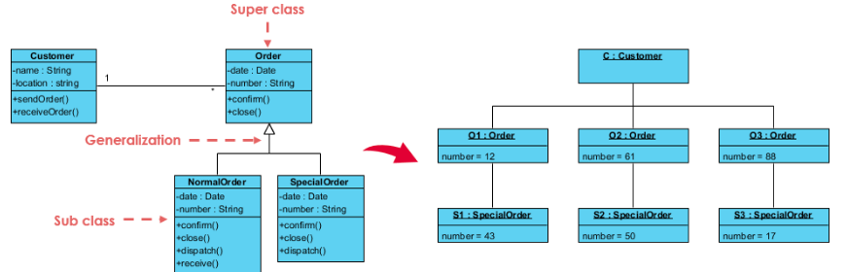
Unified Modeling Language
1. Object diagram (Static structure diagram)
An object diagram represents an instance at a particular moment, which is concrete in nature.

